Slide 1

DEEP LEARNING BASED VIRTUAL WHITEBOARD USING HAND GESTURE RECOGNITION
FINAL YEAR PROJECT
PROJECT TEAM MEMBERS
1.
Lathika M
24BAD062
2.
Priya Dharshini R
24BAD092
3.
Preethi R
24BAD091
4.
Sreenidhi S
24BAD114
Gesture-controlled virtual whiteboard (illustration)
Department: Artificial Intelligence and Data Science
College: Kumaraguru College of Technology
Course Code and Title : 24ADI006 - DEEP LEARNING
Academic Year: 2026 – 2027
Notes:
Introduce the project title and yourself.

Slide 2

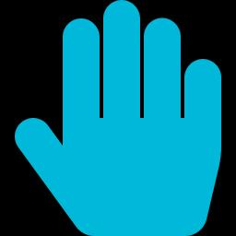


Introduction
What is a virtual whiteboard?
Why touchless interaction?
A digital canvas where users draw, edit and save content on screen instead of on a physical board.
Users draw without physical contact, markers or touch hardware, which suits teaching and presentations.
Role of computer vision and deep learning
What makes our implementation different?
OpenCV and MediaPipe track the hand; a CNN classifies the gesture and a second CNN recognizes drawn shapes.
One webcam supports drawing, object manipulation, colour filling and automatic shape correction by gesture.
Notes:
Explain what the system is, why touchless input helps, how CV and DL contribute, and what is different.

Slide 3
Problem Statement and Objectives
PROBLEM STATEMENT
OBJECTIVES
To design and implement a real-time, webcam-based virtual whiteboard that recognizes hand gestures using deep learning, enabling users to draw, select, move, resize, erase and fill drawings, and to automatically correct freehand shapes into circles, squares, rectangles and triangles without physical contact.
1
Develop a real-time virtual drawing environment
2
Recognize hand gestures using deep learning
3
Enable drawing and object manipulation
LIMITATIONS OF EXISTING APPROACHES
4
Implement automatic shape recognition and correction
Whiteboards need physical markers and a surface
Mouse drawing is indirect and less intuitive for freehand work
5
Provide digital saving, undo and redo operations
Touch drawing may need touchscreen hardware or contact
Freehand shapes can be inaccurate, especially geometric shapes
Notes:
Read the problem statement first, then the gaps in existing approaches, then the five objectives.

Slide 4
Literature Survey and Existing Systems
RELATED RESEARCH
EXISTING SYSTEMS VS PROPOSED SYSTEM
Zhang et al. (2020)
MediaPipe Hands: real-time, on-device hand tracking that provides hand landmarks, the basis of our landmark stage.
System | Interaction | Hardware | Limitation
Traditional whiteboard | Marker on a surface | Board and markers | Needs physical markers and surface
Mouse-based drawing | Mouse or trackpad | Computer and mouse | Indirect; less intuitive for freehand
Touchscreen whiteboard | Touch or stylus | Touch-enabled display | Needs touch hardware and contact
Proposed system | Hand gestures | Computer and webcam | Depends on webcam view and trained gestures
Lugaresi et al. (2019)
MediaPipe: a framework for building perception pipelines, used here to run the hand tracking.
LeCun et al. (1998)
Convolutional networks for document recognition, the foundation of the CNN-based classification used for gestures and shapes.
Notes:
Related research on the left; system comparison on the right.

Slide 5
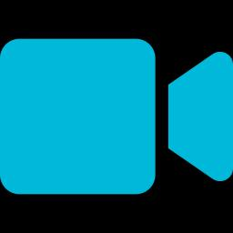
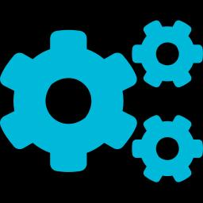
Proposed System
1
2
3
4
5
Webcam input
MediaPipe hand tracking
Gesture CNN
Action controller
Virtual drawing canvas
OpenCV captures each frame; frames are flipped and resized.
Detects the hand and returns 21 landmarks (x, y, z).
Classifies the gesture from normalized landmark features.
Turns the stabilized gesture into a canvas operation.
Draws and edits objects and shows the result live.
Shape CNN
Selected drawing → Shape CNN → automatically corrected circle, square, rectangle or triangle
Canvas management and saving
Colour fill (12-colour palette), undo and redo, clear canvas, PNG saving with black background
Notes:
Walk left to right through the main workflow, then the two supporting branches.

Slide 6

System Requirements
Hardware
Software
Model files
Computer or laptop
Webcam
Python
OpenCV
MediaPipe
TensorFlow / Keras
NumPy
Gesture CNN model file
Shape CNN model file
Python
application logic
OpenCV
frames and display
MediaPipe
hand landmarks
TensorFlow / Keras
Gesture and Shape CNNs
NumPy
array handling
Notes:
Fill processor and RAM with your actual machine.

Slide 7
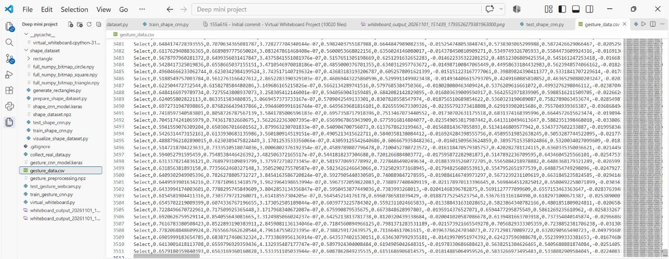
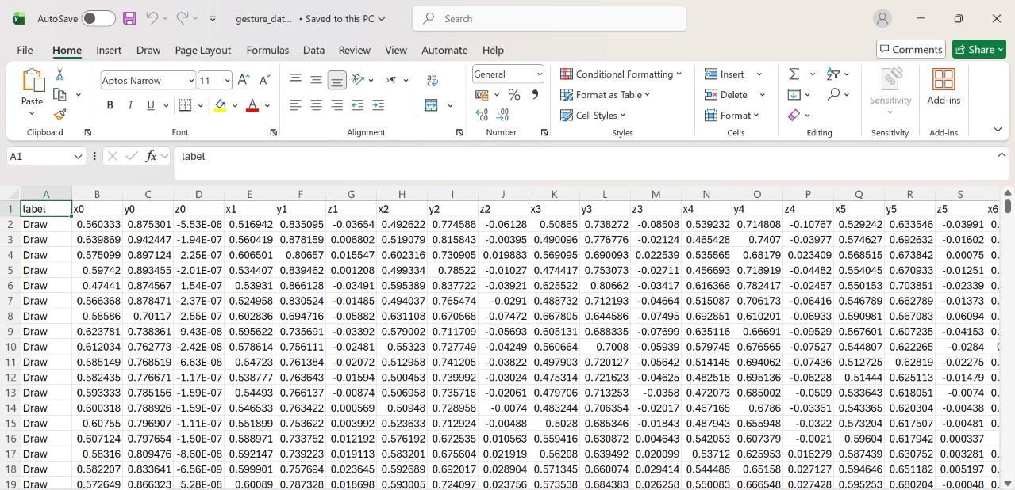
Dataset

Slide 8
System Architecture
1 · Input and frame processing
2 · Hand tracking and features
3 · Gesture recognition and control
Webcam input
MediaPipe hand landmark detection (21 landmarks)
Gesture CNN classification (confidence, history)
OpenCV: capture, flip, resize
Feature extraction and normalization
Gesture-based action controller
Application layer
4 · Drawing and object manipulation
5 · Shape recognition and correction
6 · Canvas management and saving
Draw · Select · Move · Resize · Erase · Colour fill
Selected drawing → preprocessing → Shape CNN → correction to circle, square, rectangle or triangle
Undo · Redo · Clear canvas · Save PNG (black background)
Notes:
Three processing stages feed three application modules.

Slide 9
Working Methodology
1 Capture webcam frame
2 Flip and resize frame
3 Detect hand (MediaPipe), extract 21 landmarks
4 Hand detected?
5 Normalize landmark features
No: wait for next frame
Next frame
10 Update canvas and display
9 Apply gesture operation
8 Stabilize using prediction history
7 Confidence above threshold?
6 Gesture CNN prediction
No: gesture not applied
The loop repeats for every webcam frame. On request: save PNG, undo or redo, clear the canvas and change colour.
Notes:
This is a loop: every webcam frame passes through the same steps.

Slide 10
Hand Gesture Recognition and Gesture CNN
1
Landmark extraction
21 hand landmarks, each with x, y, z coordinates
2
Feature normalization
Landmark features are normalized before classification
3
Gesture CNN
Predicts a gesture class with a confidence score
4
Stabilization
Confidence threshold and prediction history give a steady gesture label
MediaPipe: 21 landmarks (schematic)
Notes:
Landmarks go in, a gesture label comes out; history smoothing stops flicker.

Slide 11
Gesture-to-Action Mapping
Operation | Hand input used | Application response
Drawing | Index finger movement | Strokes are drawn on the canvas
Selection | Selection gesture to select an existing drawing | A single drawing is selected
Moving objects | Hand movement while holding the selected object | Selected drawing is moved without being lost at canvas boundaries
Erasing | Eraser gesture | Drawings are erased
Resizing | Thumb–index pinch distance | Selected object is resized
SmartShape correction | Gesture held on a selected drawing | Shape CNN classifies; drawing is corrected to a geometric shape
Notes:
Replace bracketed gesture names with the class labels used in your Gesture CNN.

Slide 12
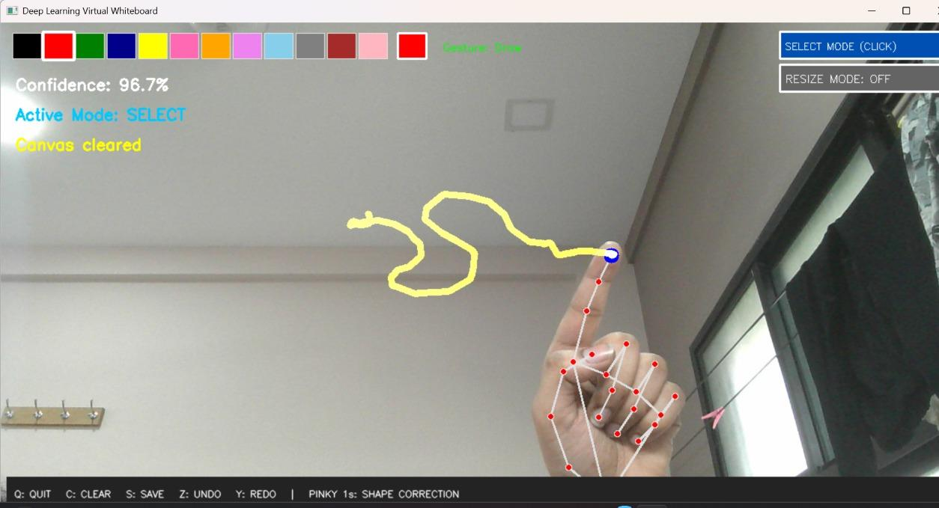
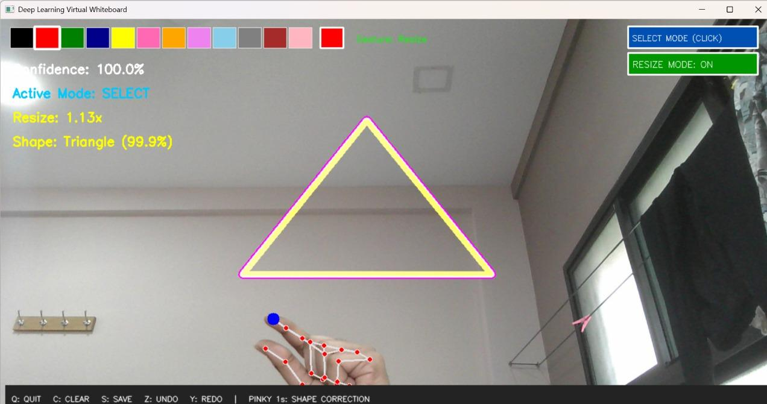


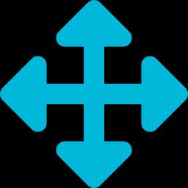
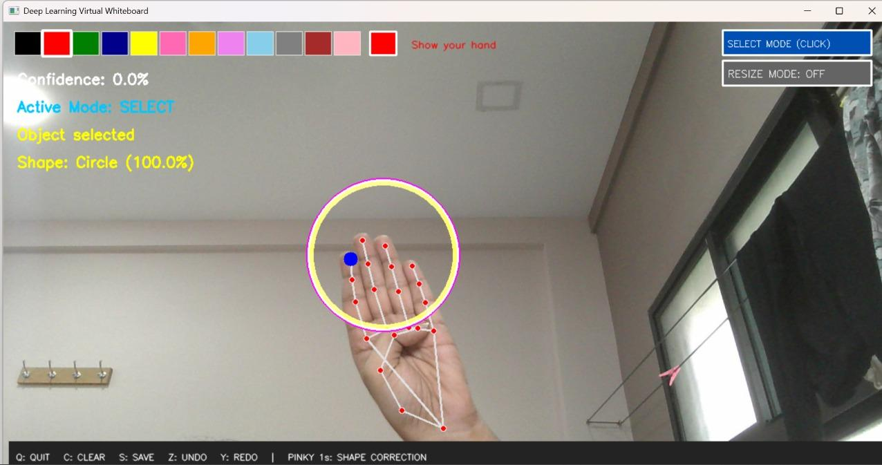
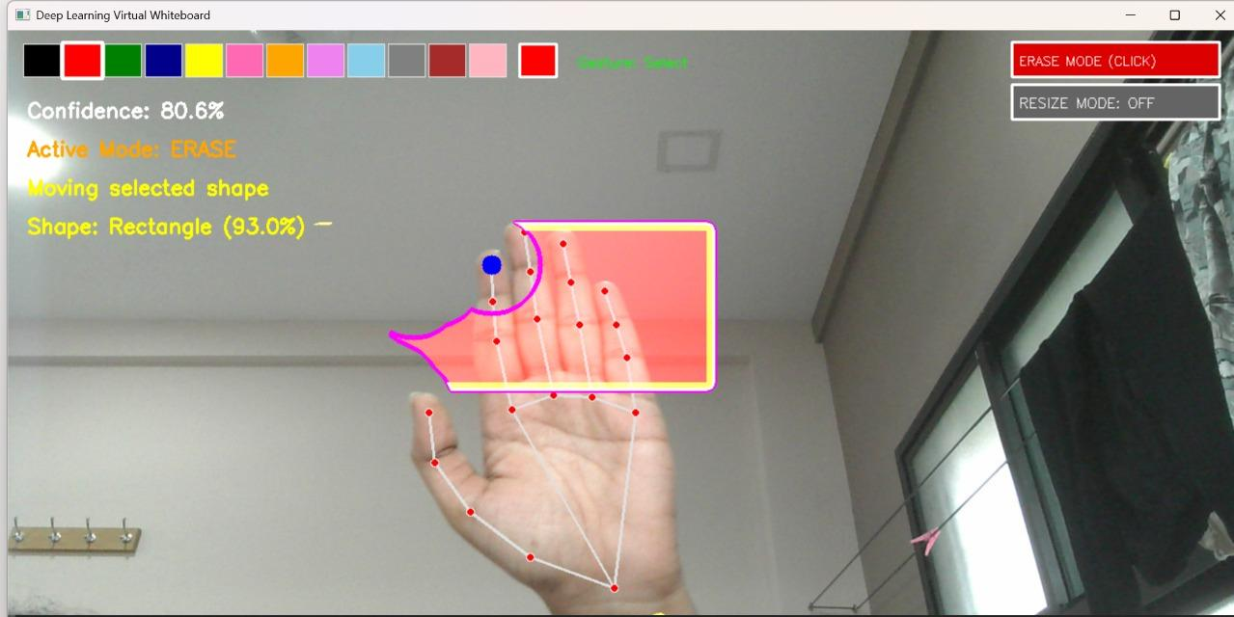


Virtual Drawing and Object Manipulation
Draw
Index finger movement
Select
Pick an existing drawing
Move
Drawing
Select and move
Drag selected objects
Resize
Thumb-index pinch distance
Erase
Eraser gesture
Resize
Erase
Notes:
Show each operation in the screenshots.

Slide 13
SmartShape Recognition and Shape CNN
Hold SmartShape gesture
Identify selected drawing
Extract drawing contour
Preprocess image
Classify with Shape CNN
Correct to geometric shape
Before and after (illustration)
Supported classes
Circle
Square
Hand-drawn
Corrected
Illustration only, not an actual project output
Rectangle
Triangle
Notes:
Hold the gesture, classify the drawing, replace it with the ideal shape.

Slide 14
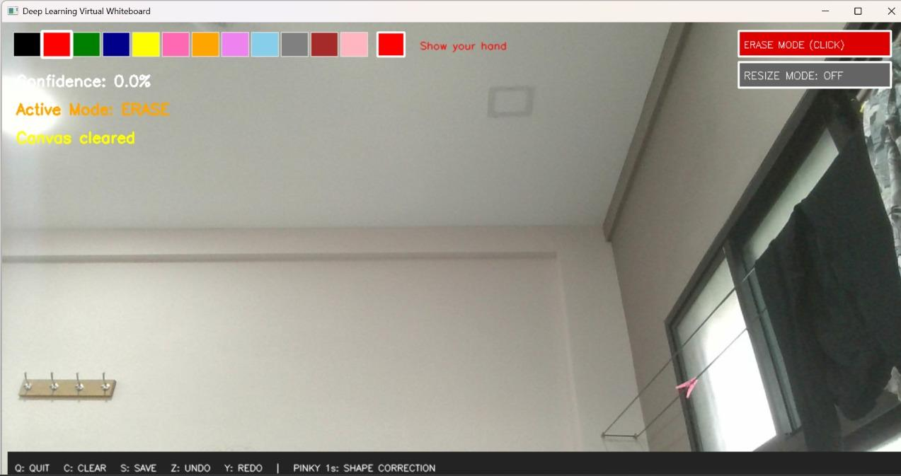



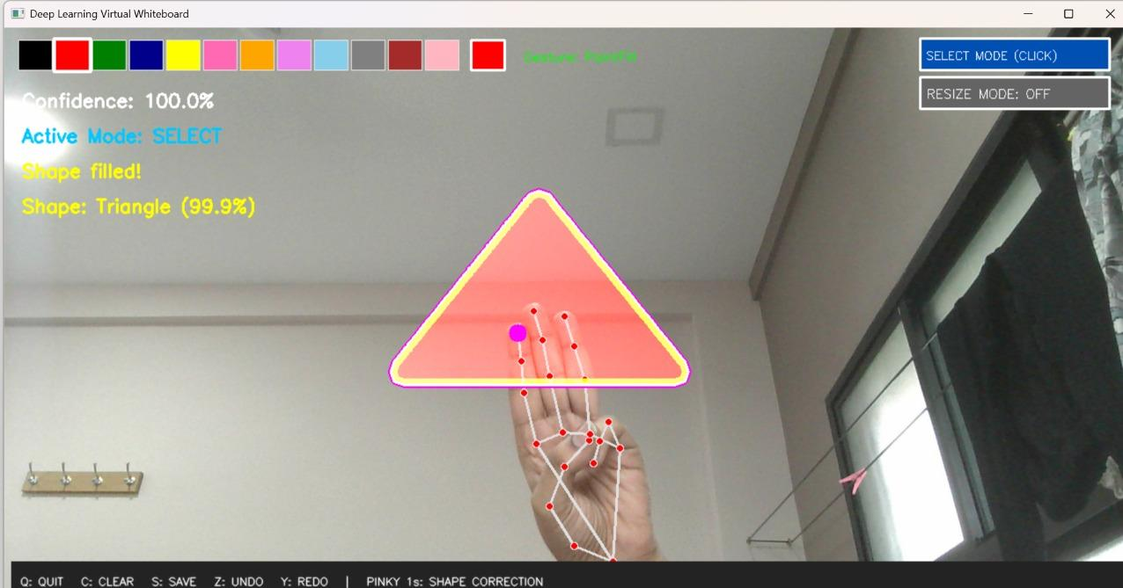


Colour Filling and Canvas Management
Choose from 12 colours
Select a drawing
Fill a closed shape
Undo and redo
12-colour palette
Clear the canvas
Save as PNG (black background)
Filled closed shapes
Notes:
Fill works on selected closed shapes.

Slide 15
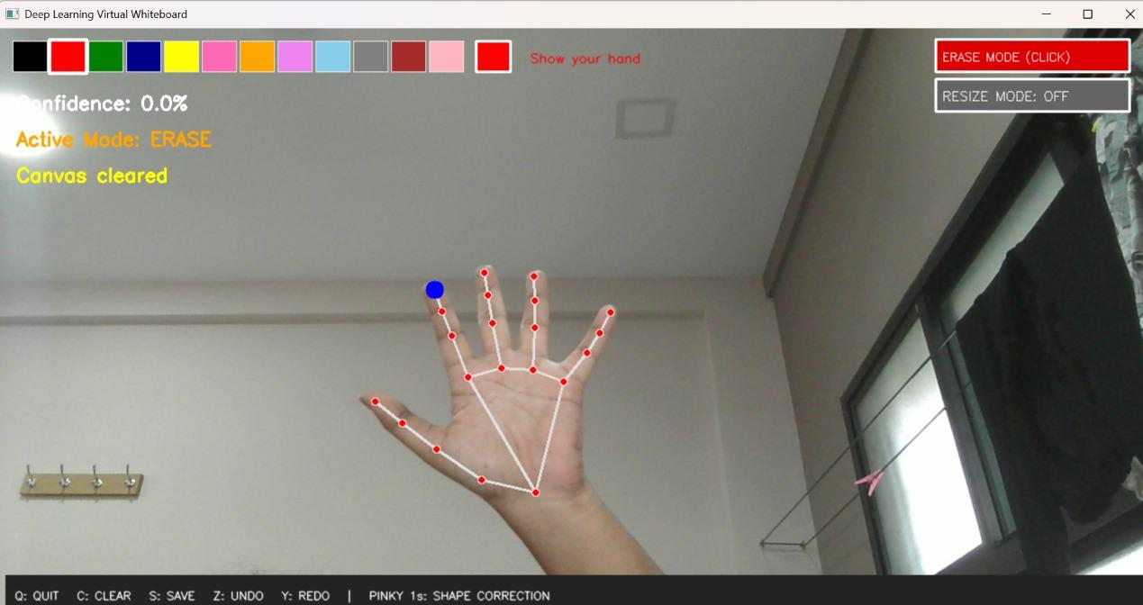
User Interface and Implementation
1
Webcam display
2
Virtual drawing canvas
3
Colour palette
4
Select/Erase toggle
5
Resize Mode button
6
Gesture status
7
Confidence display
8
Keyboard shortcuts
Full application window
Notes:
Point out each numbered component on the screenshot.

Slide 16
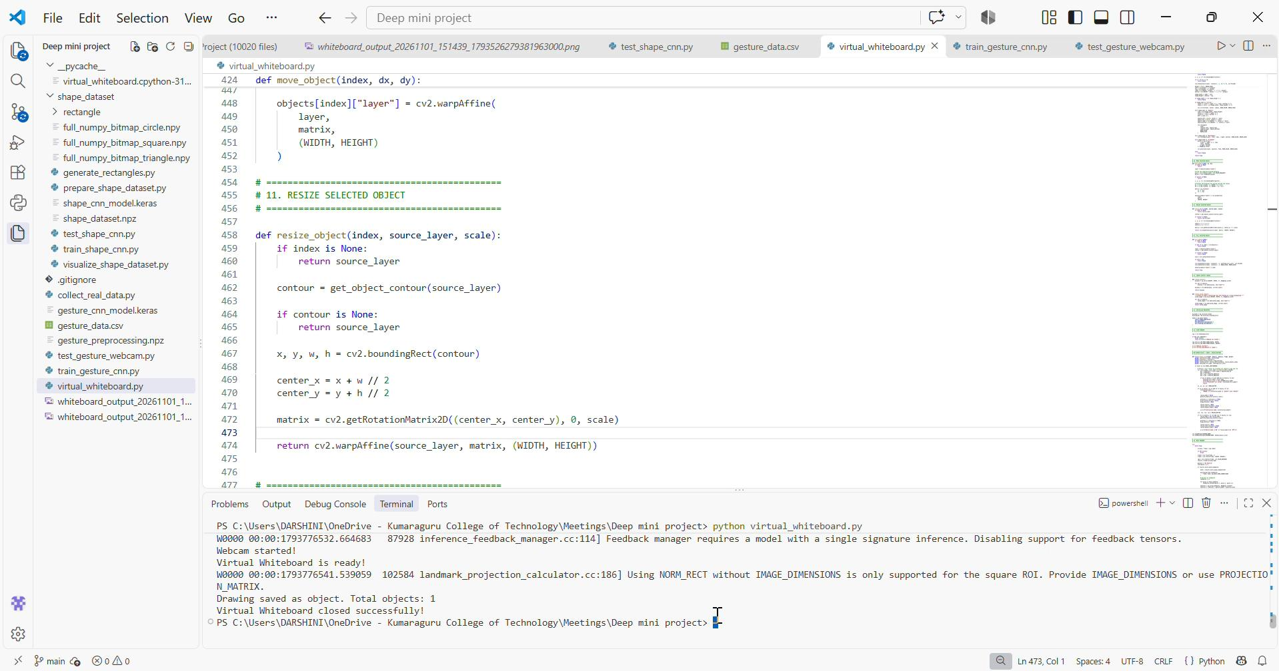
LIVE PROJECT DEMONSTRATION
1
2
3
4
5
6
7
8
Start the webcam
Demonstrate gesture recognition
Draw a shape
Select and move the drawing
Resize the drawing
Fill it with colour
Perform automatic shape correction
Save the final drawing
Notes:
Insert the recorded demo via Insert > Video, over the placeholder.

Slide 17
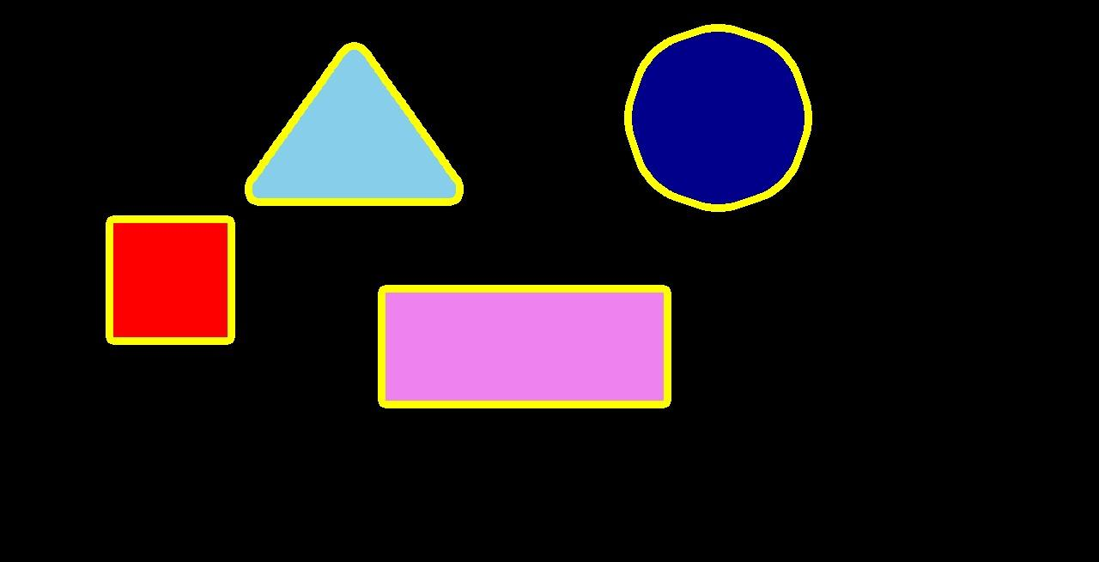
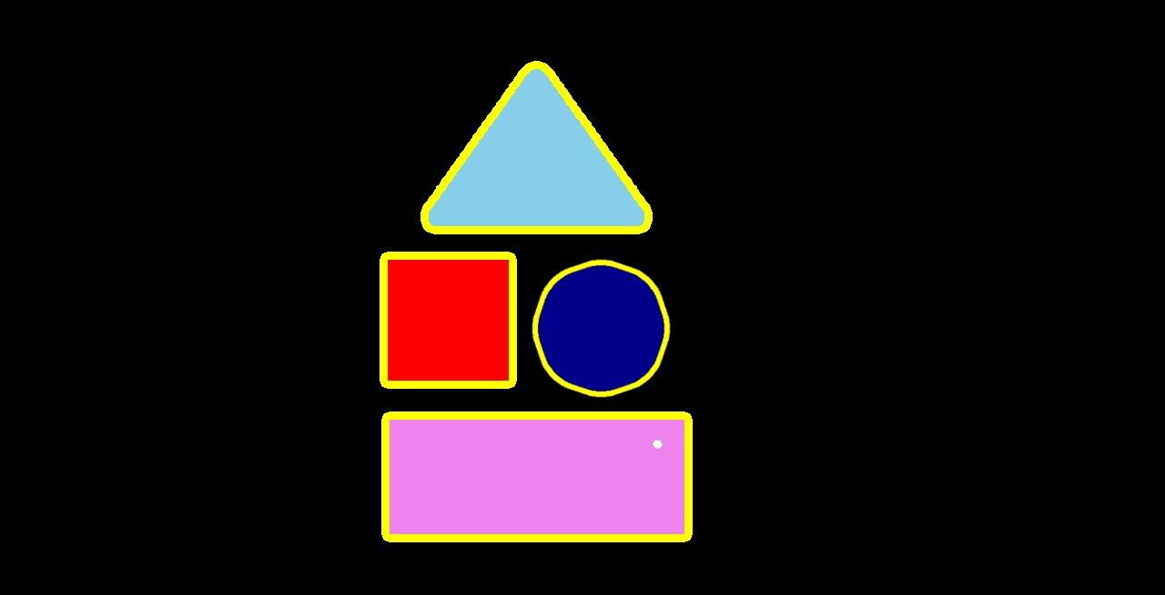
Result
Notes:
Insert screenshots and fill the tables only with values you measured.

Slide 18
Advantages, Limitations and Future Enhancements
Advantages
Limitations
Future Enhancements
IMPLEMENTED
CURRENT VERSION
PROPOSED – NOT IMPLEMENTED
Touchless interaction
Real-time drawing
Easy object manipulation
Automatic shape correction
Digital storage as PNG
User-friendly interaction
Works with a single hand
Limited to the trained gesture classes
Shape correction covers four shapes only
PNG saving only, no cloud storage
Webcam view and conditions may affect recognition [ confirm from testing ]
Multi-hand support
Additional gesture classes
More geometric shapes
Cloud storage
Online collaboration tools
Notes:
Only the right-hand column is proposed work.

Slide 19
Conclusion, References and Thank You
WHAT WAS IMPLEMENTED
HOW IT ADDRESSES THE PROBLEM
Gesture-based drawing with real-time hand tracking
Selection, movement, pinch resizing and erasing
SmartShape correction with the Shape CNN
Colour filling with a 12-colour palette
Undo, redo, clear canvas and PNG saving
Markers and surfaces
Webcam and digital canvas
Indirect mouse interaction
Hand-gesture drawing
Touch hardware and contact
Touchless interaction
Inaccurate freehand shapes
Shape CNN correction
REFERENCES
[1] Zhang et al. (2020). MediaPipe Hands. arXiv:2006.10214
[2] Lugaresi et al. (2019). MediaPipe framework. arXiv:1906.08172
[3] Bradski (2000). The OpenCV Library. Dr. Dobb's Journal
[4] Abadi et al. (2016). TensorFlow. USENIX OSDI, pp. 265–283
[5] Chollet et al. (2015). Keras. keras.io
[6] Harris et al. (2020). Array programming with NumPy. Nature 585
[7] LeCun et al. (1998). Gradient-based learning applied to document recognition. Proc. IEEE 86(11)
GitHub link : https://github.com/Priya-DharshiniRamesh/Deep-Learning-Virtual-Whiteboard/tree/main
THANK YOU ·
Notes:
Summarize achievements, link them to the problem statement, then close.

